Slide 1
Variant Annotation Workflow to Classify SNPs from Genomic Data
By Gopalakrishnan Kumar, MTech IIT-Bombay,
Freelance Data Science Consultant
LinkedIn: Profile Link : https://www.linkedin.com/in/gopalakrishnankumar-a73301110/
Github:https://www.github.com/Gopal21236
Kaggle URL- https://www.kaggle.com/gopalkk2

Slide 2
Google Colab URL
https://colab.research.google.com/drive/1nSTByEqoQqYJqs8mB8VE2kO-nxolxK6m?usp=sharing

Slide 3
Introduction
Genomic variations play a crucial role in understanding genetic diversity and disease mechanisms. Among these variations, Single Nucleotide Polymorphisms (SNPs) are the most common type. SNPs can influence gene function and may lead to diseases if they are pathogenic.
This project focuses on developing a machine learning-based pipeline to analyze genomic data, annotate SNPs, and classify them as pathogenic or benign. The integration of bioinformatics tools and machine learning enables efficient and scalable genomic analysis.

Slide 4
Objectives
To process genomic data (VCF/CSV format)
To perform SNP extraction and preprocessing
To annotate variants with biological information
To build a machine learning model for SNP classification
To evaluate model performance using standard metrics

Slide 5
Background
SNPs represent a change in a single nucleotide (A, T, C, G) in the DNA sequence. These variations can be:
Synonymous → No change in protein
Non-synonymous → Alters protein function
Nonsense → Introduces stop codon
Annotation tools like Ensembl VEP and SnpEff provide functional information about SNPs, which is essential for classification.

Slide 6
Data Collection
The dataset used in this project includes annotated SNP data obtained from:
ClinVar
Kaggle genomic datasets
Data Format:
VCF (raw genomic data)
CSV (annotated and ML-ready data)

Slide 7
Data Preprocessing
Steps:
Removal of missing values
Filtering SNPs (single nucleotide variants)
Encoding categorical variables
Normalization of numerical features
DNA Encoding:
A → 0
C → 1
G → 2
T → 3

Slide 8
Feature Engineering
Important features extracted:
Chromosome (chrom)
Position (pos)
Gene name
Variant consequence
Impact level
Reference and alternate alleles
These features help the model learn biological patterns.

Slide 9
Machine Learning Model
Model Used:
Random Forest Classifier
Why Random Forest?
Handles categorical + numerical data
Robust to overfitting
Provides feature importance

Slide 10
Model Training
Steps involved:
Train-test split (80:20)
Feature scaling using StandardScaler
Model training using Random Forest

Slide 11
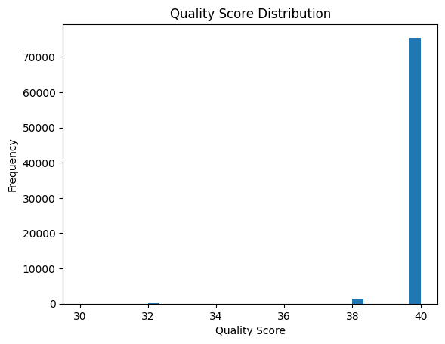
Data Visualization

Slide 12
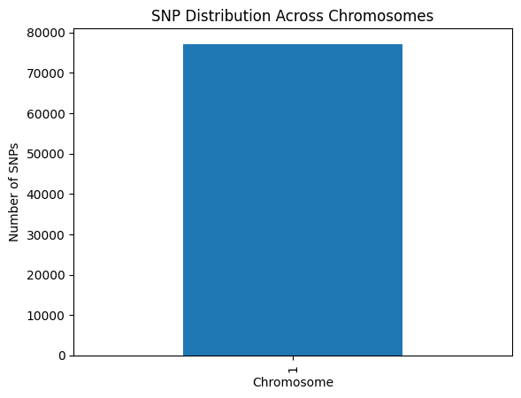
Data Visualization

Slide 13
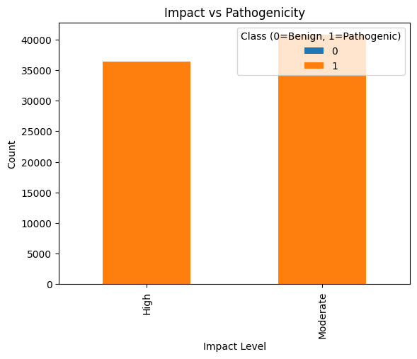
Data Visualization

Slide 14
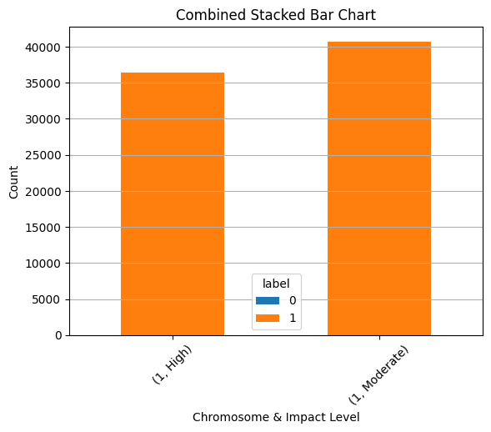
Data Visualization

Slide 15
Model Evaluation
Metrics used:
Accuracy
Precision
Recall
F1-score
ROC-AUC
Key Insight:
The model achieved good performance in distinguishing pathogenic and benign SNPs.

Slide 16
Results
The model successfully classified SNPs based on input features
Variant consequence and impact were found to be highly influential
Visualization revealed patterns in mutation distribution

Slide 17
Applications
Disease prediction
Precision medicine
Genetic research
Drug discovery

Slide 18
Challenges
High-dimensional genomic data
Class imbalance
Lack of labeled datasets
Complexity in biological interpretation

Slide 19
Future Scope
Use Deep Learning (CNN, LSTM)
Integrate real-time genomic pipelines
Use larger datasets
Deploy as a web application
Incorporate multi-omics data

Slide 20
Conclusion
This project demonstrates the effective use of machine learning in genomic data analysis. By integrating variant annotation and predictive modeling, the system can classify SNPs efficiently. The approach enhances the ability to interpret genetic variations and contributes to advancements in precision medicine.

